Slide 1
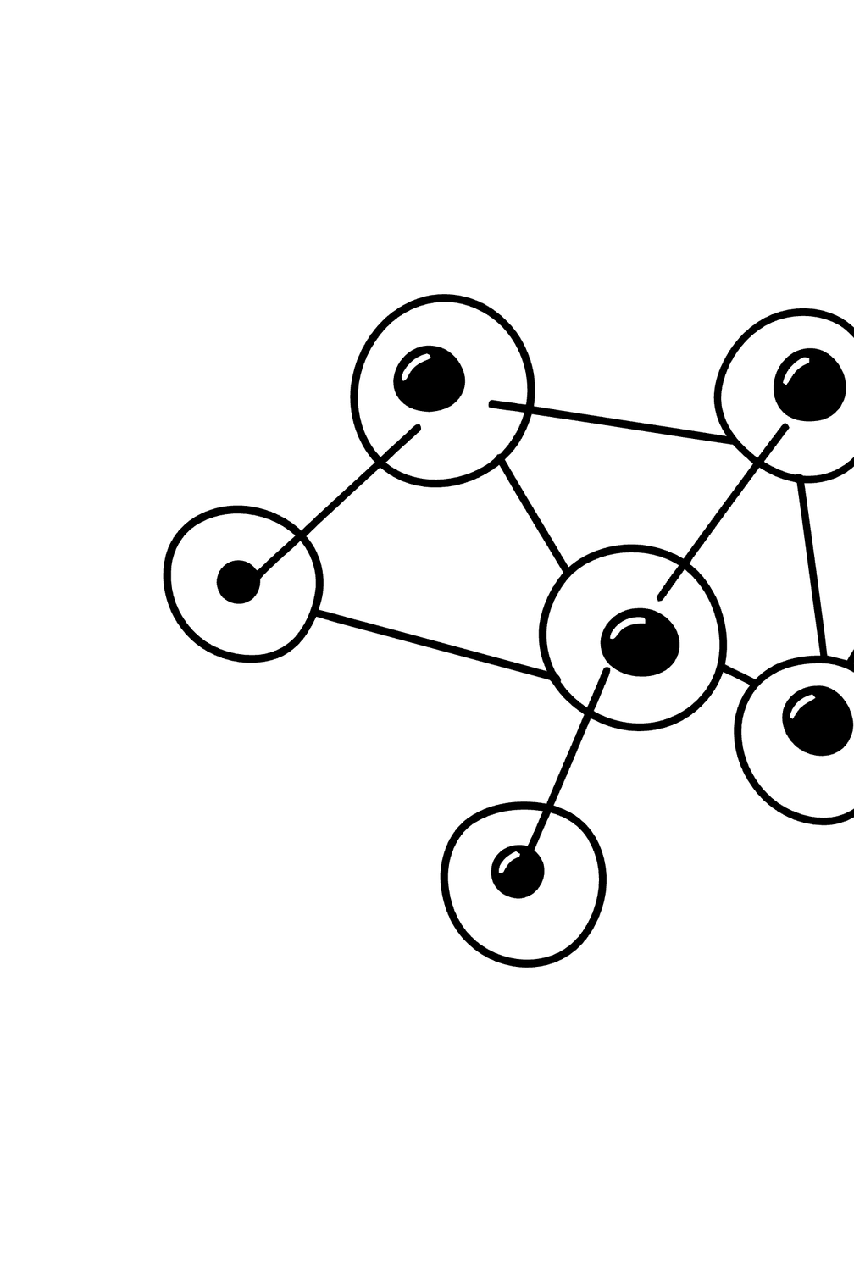

Adaptive Risk-Taking and Systemic Risk in a Heterogeneous Financial Network
Private incentives, network losses, and system-aware risk optimization
Presenter: Himanshu Sahoo, IIT(BHU)
Research question: How does the fraction and intensity of risk-taking affect private returns and systemic losses in an interconnected financial network?
Notes:
1

Slide 2


Motivation
In an interconnected financial system, an institution chooses how much risk to take, but its failure can impose losses on other institutions through interbank obligations.
Core Tension
Private Upside
Network Downside
More risk can improve private returns for the individual institution.
More risk can increase network distress across interconnected institutions.
The Divergence
The privately optimal decision need not be system-optimal.
This is a computational investigation, not a reproduction of a published theorem.
Notes:
2

Slide 3
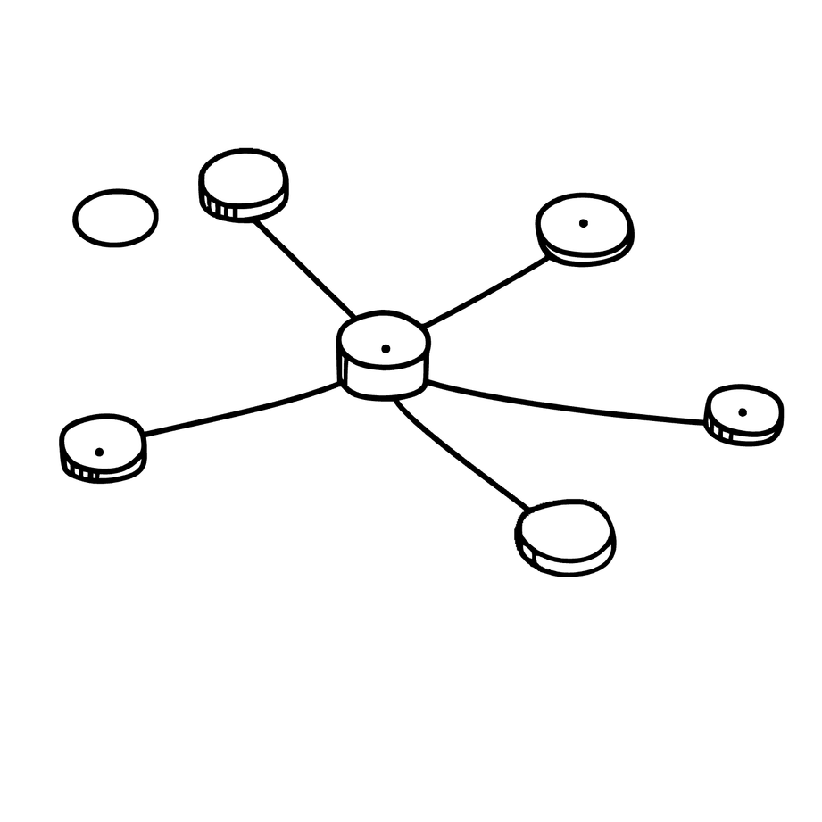
Model: Heterogeneous Financial Network
Network Structure
N institutions are nodes; a directed edge i→j means institution i owes institution j an interbank amount Eij.
Each Institution Has
  External assets Ai
  External liabilities Xi
  Interbank obligations Bi = Σj Eij
  Strategy si ∈ {L, R} (Low or Risky)
Heterogeneity
Captured through connection probabilities pLL, pRR, pLR, pRL. Baseline: pLL = pRR = pw and pLR = pRL = pc.
Network structure determines how distress can propagate through the system.
Notes:
3

Slide 4
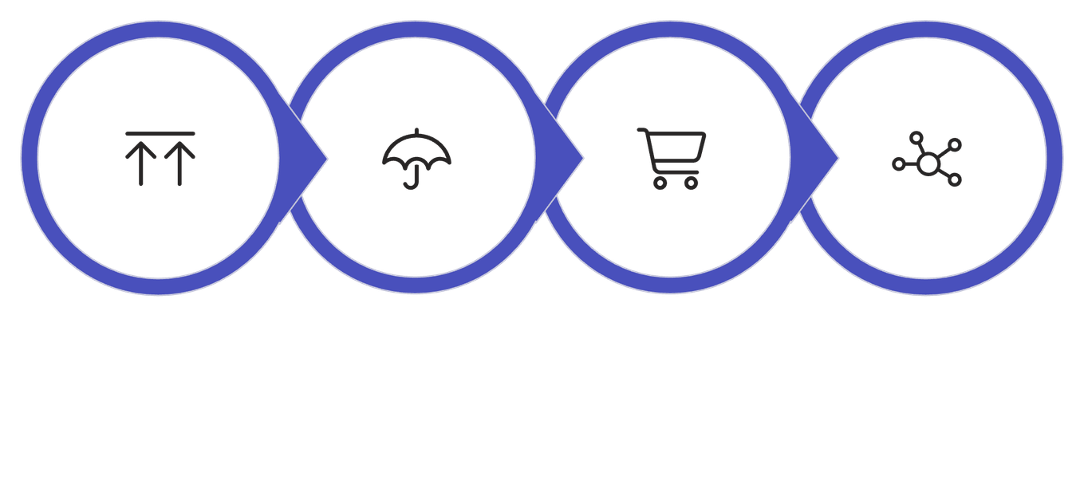
Risk → Shock → Clearing → Contagion
Risk Choice
External Shock
Payment Clearing
Contagion
Key Variables
Clearing Mechanism
  q_i: risky-asset fraction (q_R > q_L)
  A'_i = A_i[(1-q_i) + q_i R_i]: post-shock external assets
  I_i = Σ_j r_j E_ji: interbank inflows received
  F_i = A'_i + I_i: total funds available
The recovery rate ri = min(1, max(0, (Fi − Xi) / Bi)) is the fraction of interbank obligations paid by institution i. When ri < 1, the shortfall propagates as a loss to creditor institutions.
Notes:
4

Slide 5



Measuring Systemic Risk
Binary Measure
Continuous Measures (Preferred)
D = defaults / N; a systemic event is declared if D ≥ 0.30. Note: τ = 0.30 is experiment-specific, not a universal threshold.
However, binary systemic failure stayed at 0% in the main risk-intensity experiment while partial distress increased substantially.
Mean Payment Shortfall
S = mean(1 − ri)
Distressed-Bank Fraction
Share of institutions with ri < 1
Mean Unpaid Interbank Obligations
L = mean unpaid interbank obligations
"No systemic collapse" is not equivalent to "no systemic effect." Binary metrics can mask significant partial distress.
Notes:
5

Slide 6
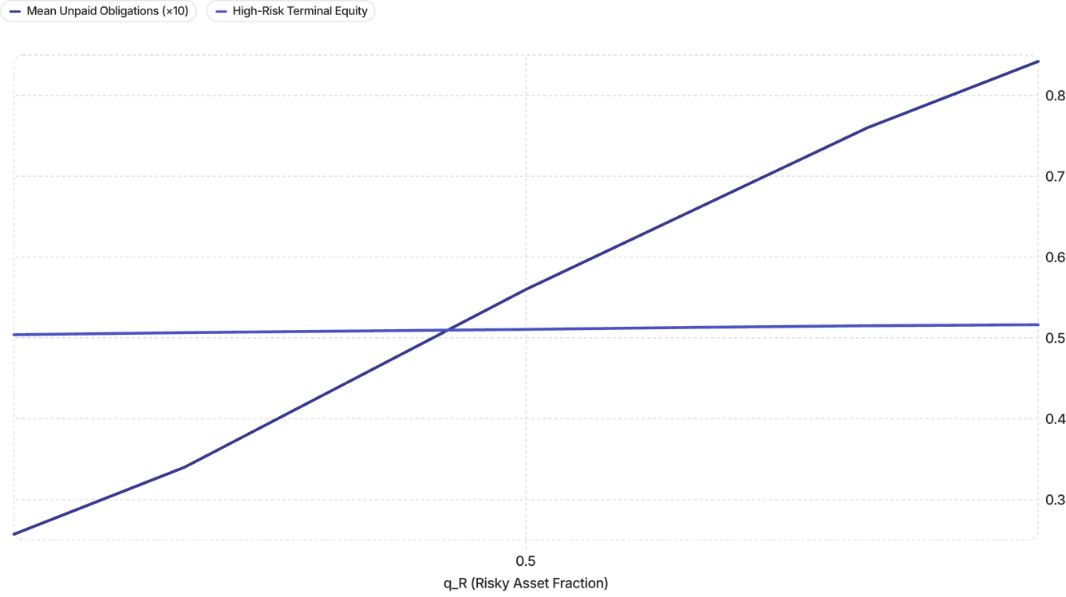
Experiment 1: Risk Intensity
Setup: qL = 0.20; qR grid from 0.20 to 0.80; 2,000 trials per point; seed 20261001.
Exact Monte Carlo grid results. Solid line = terminal equity; dashed line = mean unpaid interbank obligations (separate y-axes).
Endpoint Values
0.5039→0.5163
0.0257→0.0842
0.41%→0.94%
Terminal Equity
Unpaid Obligations
Distressed Banks
High-risk institutions as qR rises from 0.20 to 0.80
Mean unpaid interbank obligations across the qR grid
Fraction of distressed institutions at endpoints
Systemic failure probability: 0% throughout — yet partial distress grew substantially.
Notes:
6

Slide 7
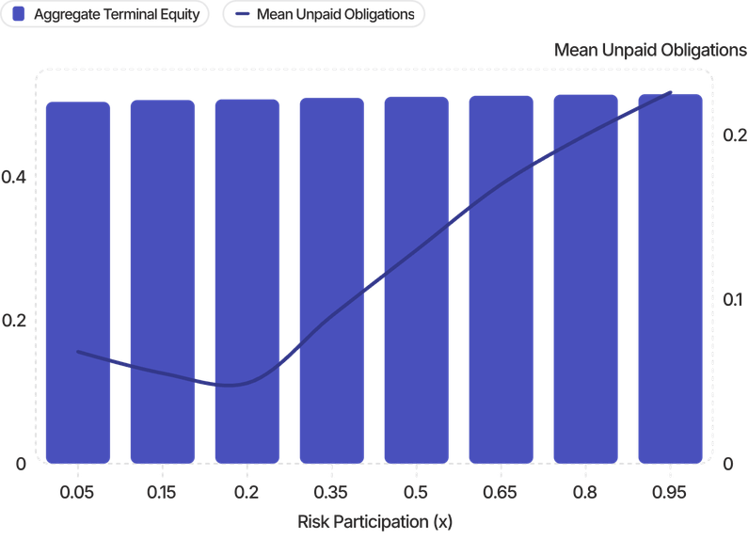


Experiment 2: Risk Participation
Setup: x = fraction of institutions using the high-risk strategy. q_L = 0.20, q_R = 0.80; x = 0.05, …, 0.95; 2,000 trials per point; common random-number seeds reused across x values.
Key Observations
Equity Rises Modestly
Aggregate terminal equity: 0.5045 at x = 0.05 → 0.5152 at x = 0.95
Obligations Surge
Mean unpaid interbank obligations: 0.0681 at x = 0.05, minimum near x = 0.20, then 0.2259 at x = 0.95
Distress Grows
Solid line = aggregate terminal equity; dashed line = mean unpaid interbank obligations. Simulated grid results.
Distressed-bank fraction reaches 2.106% at x = 0.95
Widespread risk-taking creates a much larger network externality than isolated risk-taking.
Notes:
7

Slide 8
System-Aware Optimization
Objective: J = U − λL, where U = relevant terminal-equity payoff; L = mean unpaid interbank obligations; λ = weight on systemic damage.
Optimal Risk Intensity (qR)
Optimal Risk Participation (x)
λ (Systemic Weight) | Best Tested qR
0 (private only) | 0.80
0.05 | 0.80
0.10 | 0.80
0.20 | 0.50
0.50 | 0.35
λ (Systemic Weight) | Best Tested x
0 (private only) | 0.95
0.05 | 0.55
0.10 | 0.40
0.20 | 0.30
0.50 | 0.20
Internalizing systemic losses shifts the preferred choice toward less risk. These are discrete-grid optima, not continuous analytical optima or equilibrium proofs.
Notes:
8

Slide 9

Adaptive Dynamics
Update Rule
Illustrative Run Parameters
  Initial participation: x0 = 0.50
  Learning rate: η = 0.10
  Strategies: qL = 0.20, qR = 0.80
  Steps: 20; Replications: 100
  Final x ≈ 0.5064
Interpretation
The risky strategy had a positive private payoff advantage, but the population update was slow. This is a computational population-dynamics analogue, not behavioural calibration or proof of convergence.
Summary
  Private return rises with risk in the tested range
  Network losses rise faster once risk is widespread or intense
  System-aware objective produces lower/interior tested choices
Notes:
9

Slide 10


Conclusions, Limitations & Next Steps
Conclusions
Limitations
1
Incentive Divergence
  Simulated networks and simplified balance sheets
  Two-state risky return distribution
  Simplified behavioural update rule
  Finite network size effects
  Experiment-specific systemic-loss objective
  Broad robustness study not yet completed
Private incentives and systemic stability can diverge significantly in interconnected networks.
2
Continuous Measures Matter
Continuous distress measures reveal effects hidden by binary collapse metrics.
Monte Carlo uncertainty is conditional on the model; it does not validate the model.
3
Internalizing Losses
Internalizing network losses changes preferred risk intensity and participation.
Next Steps
  Robustness across seeds, N, shock severity, and parameter scales
  Alternative systemic-loss definitions
  Only later consider ML/data-driven extensions
"The computational model is frozen; the next step is validation and deeper theoretical analysis."
Notes:
10

